Slide 1
Chapter 3 figures

Slide 2
7.5 mm
3 mm
100 nm Ge
30 nm SiNx
500 μm Si
7.5 mm
3 mm
100 nm Ge
30 nm SiNx
500 μm Si
Notes:
Sample_Geometry.png

Slide 3
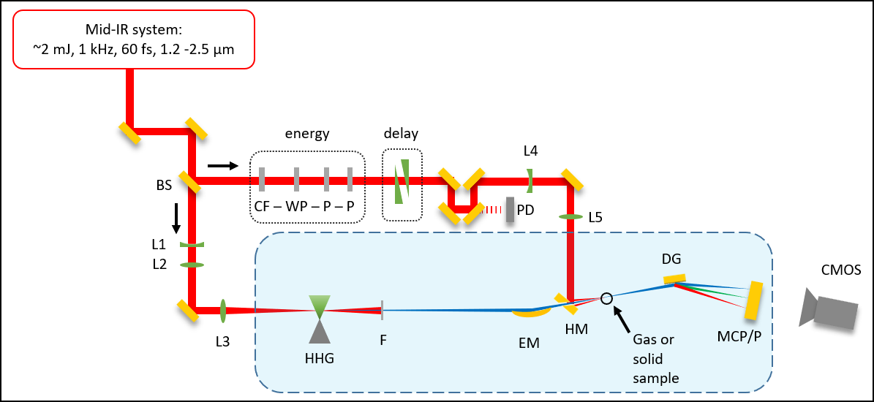
Beamline cartoon (image)
S
S

Slide 4



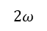
Beamline cartoon (editable)
Mid-IR system:
~2 mJ, 1 kHz, 60 fs, 1.2 -2.5 μm
energy
delay
S
L4
BS
CF – WP – P – P
W
PD
L5
S
L1
DG
L2
CMOS
I
L3
$$2ω$$
F
EM
HM
SH
MCP/P
HHG

Slide 5
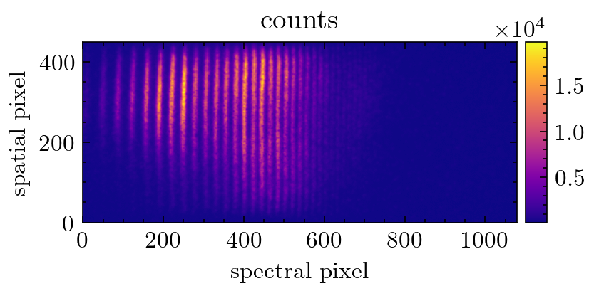
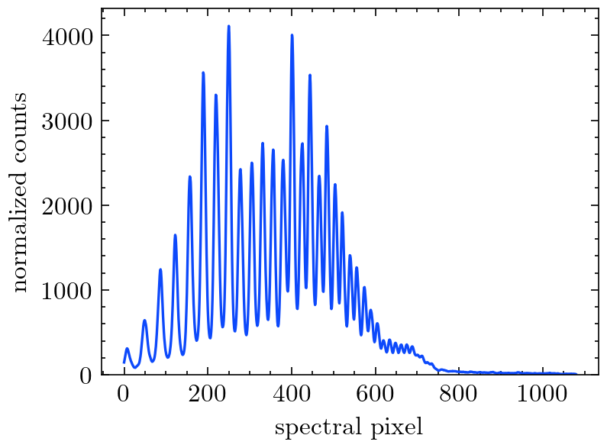
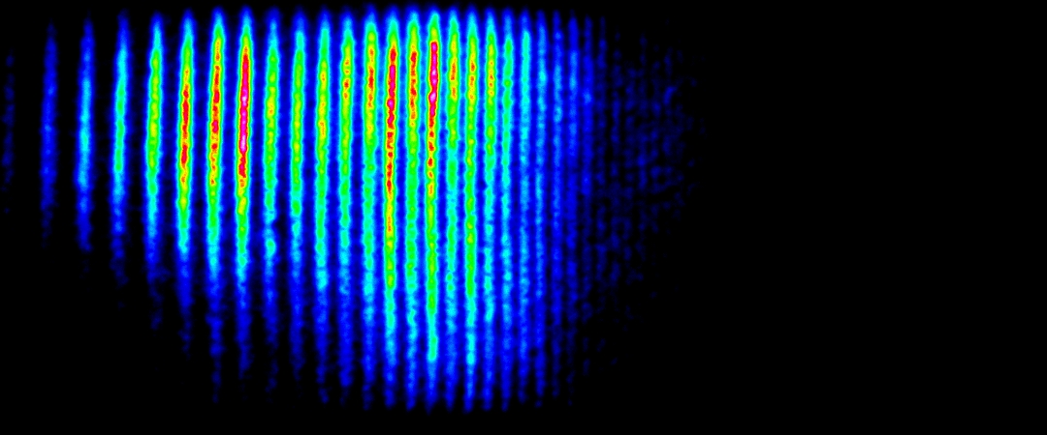
2D spectrometer image
Raw 2D image
Spectral lineout
Filtering
Delta-OD calculation
Delta-OD normalization
Average delta-OD
Energy calibration
Background subtraction, exposure time normalization, normalized spatial integration,

Slide 6
Imaging the samples under vacuum
C
1 inch
FM
HM
SH
1 inch
L

Slide 7
Finding temporal overlap in vacuum (or vented)
PA
FM
HM
SH
GA
L
C

Slide 8
Si, 260 nm
Si, one hole <200μm
“popped” 30 nm SiN

Slide 9
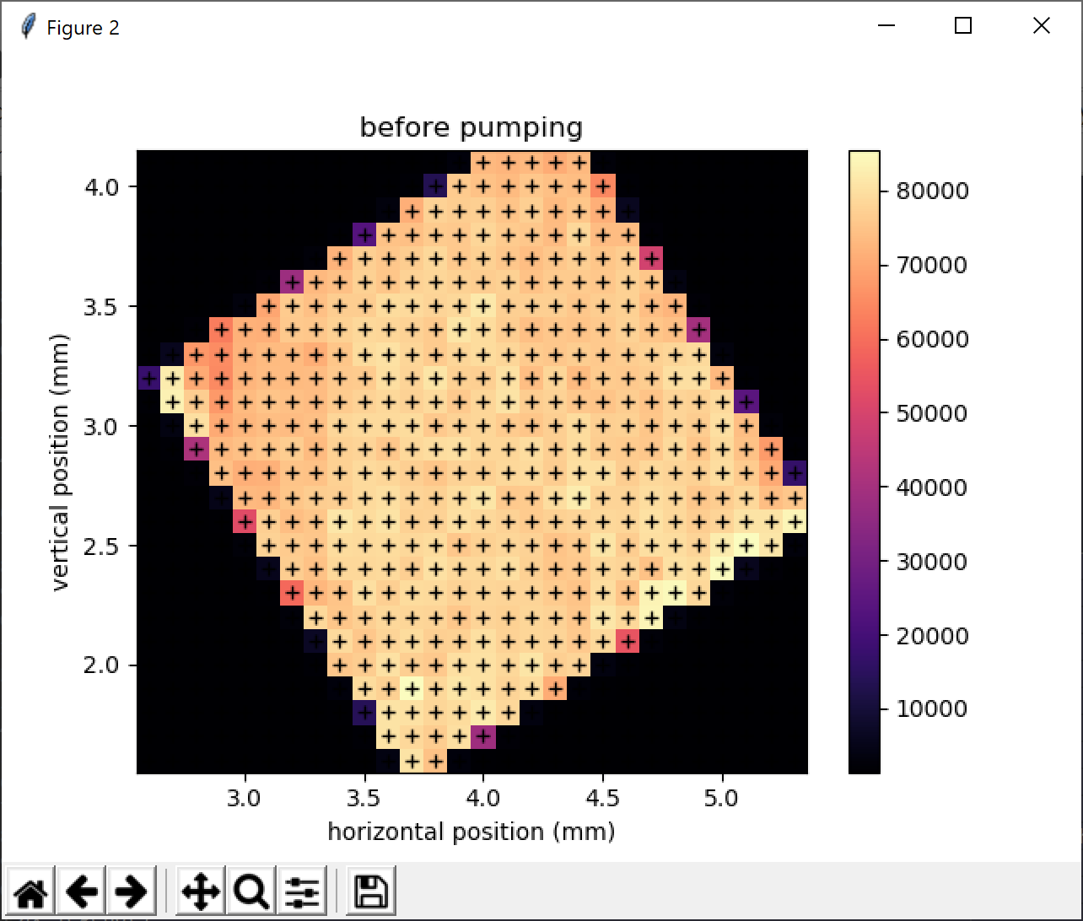
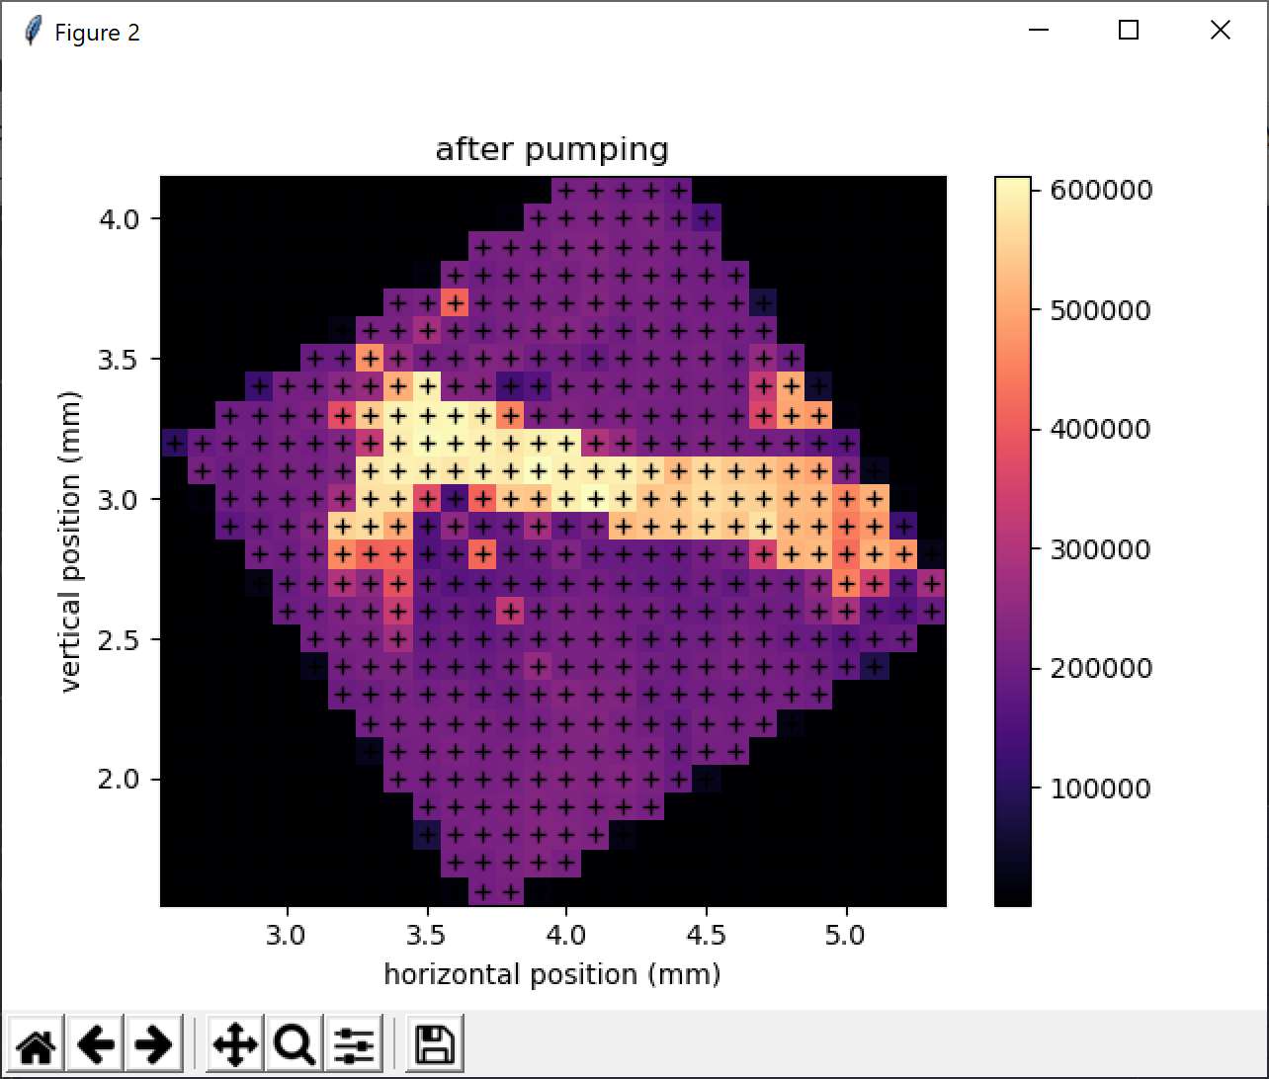
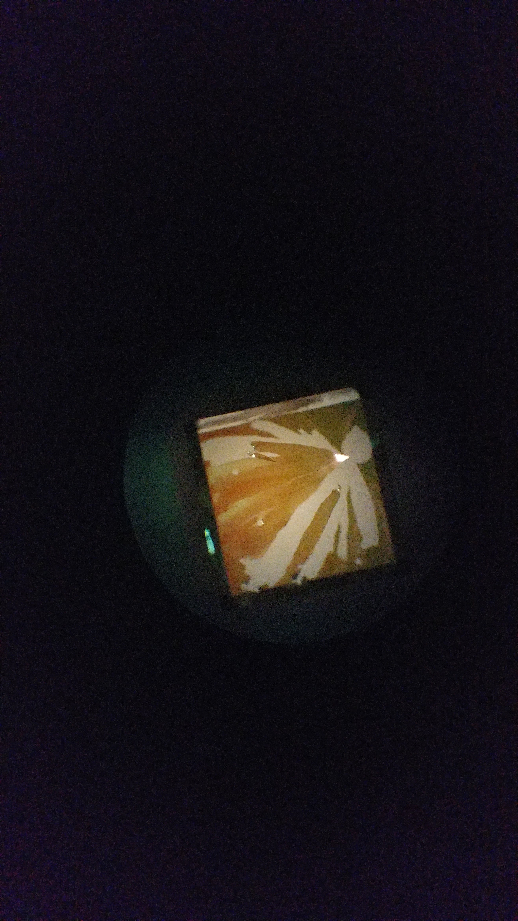
200 nm Si
200 nm Si
200 nm Si
IR-pumped areas
microscope image
Notes:
Figures from 2019-04-19 powerpoint presentation … “before pumping” was 4/09/2019 map1. “after pumping” was 4/10/2019 map1.

Slide 10
Si, 260 nm
Si, one hole <200μm
“popped” 30 nm SiN
200 nm Si
200 nm Si
200 nm Si
IR-pumped areas
microscope image
Notes:
Figures from 2019-04-19 powerpoint presentation … “before pumping” was 4/09/2019 map1. “after pumping” was 4/10/2019 map1.

Slide 11
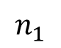
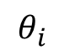
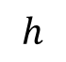
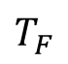
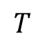
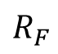
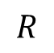
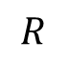
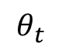
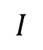
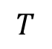
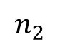
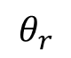
Fresnel geometry
a)
b)
$$h$$
$$I$$
interface
$$T$$
$$T_{F}$$
$$θ_{i}$$
normal
$$θ_{r}$$
$$θ_{t}$$
$$R$$
$$R$$
$$T$$
$$R_{F}$$
$$n_{1}$$
$$n_{2}$$

Slide 12
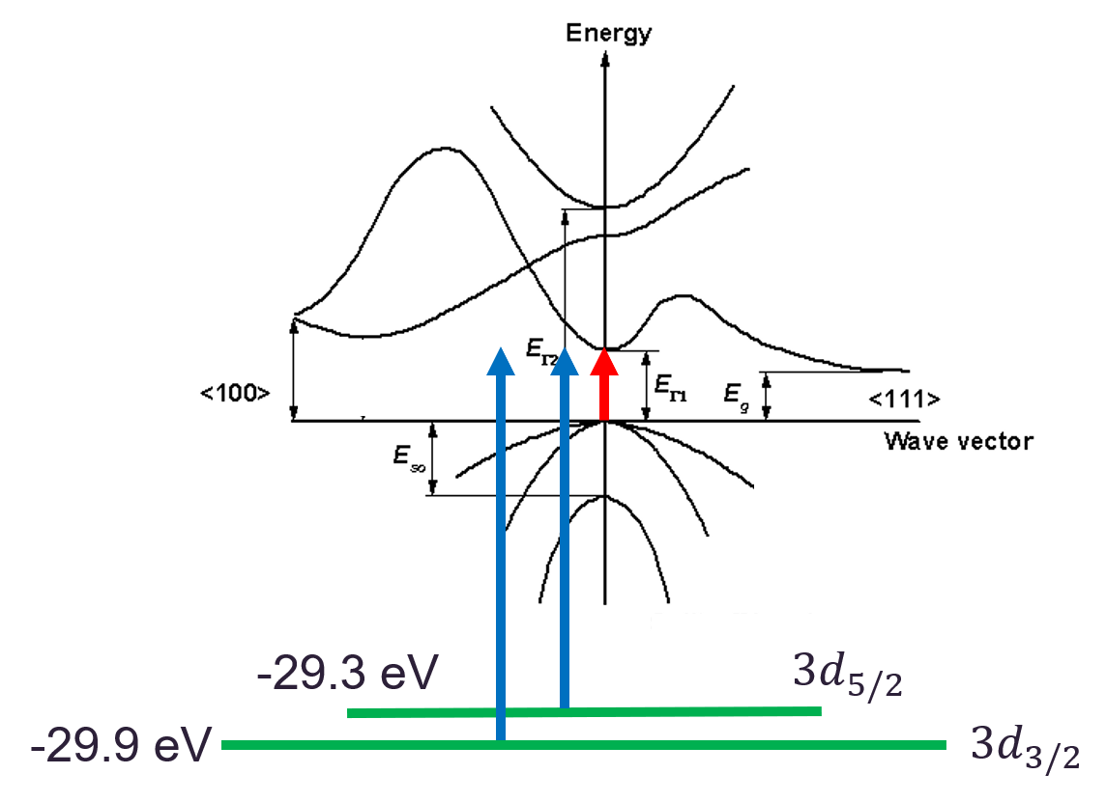

Slide 13
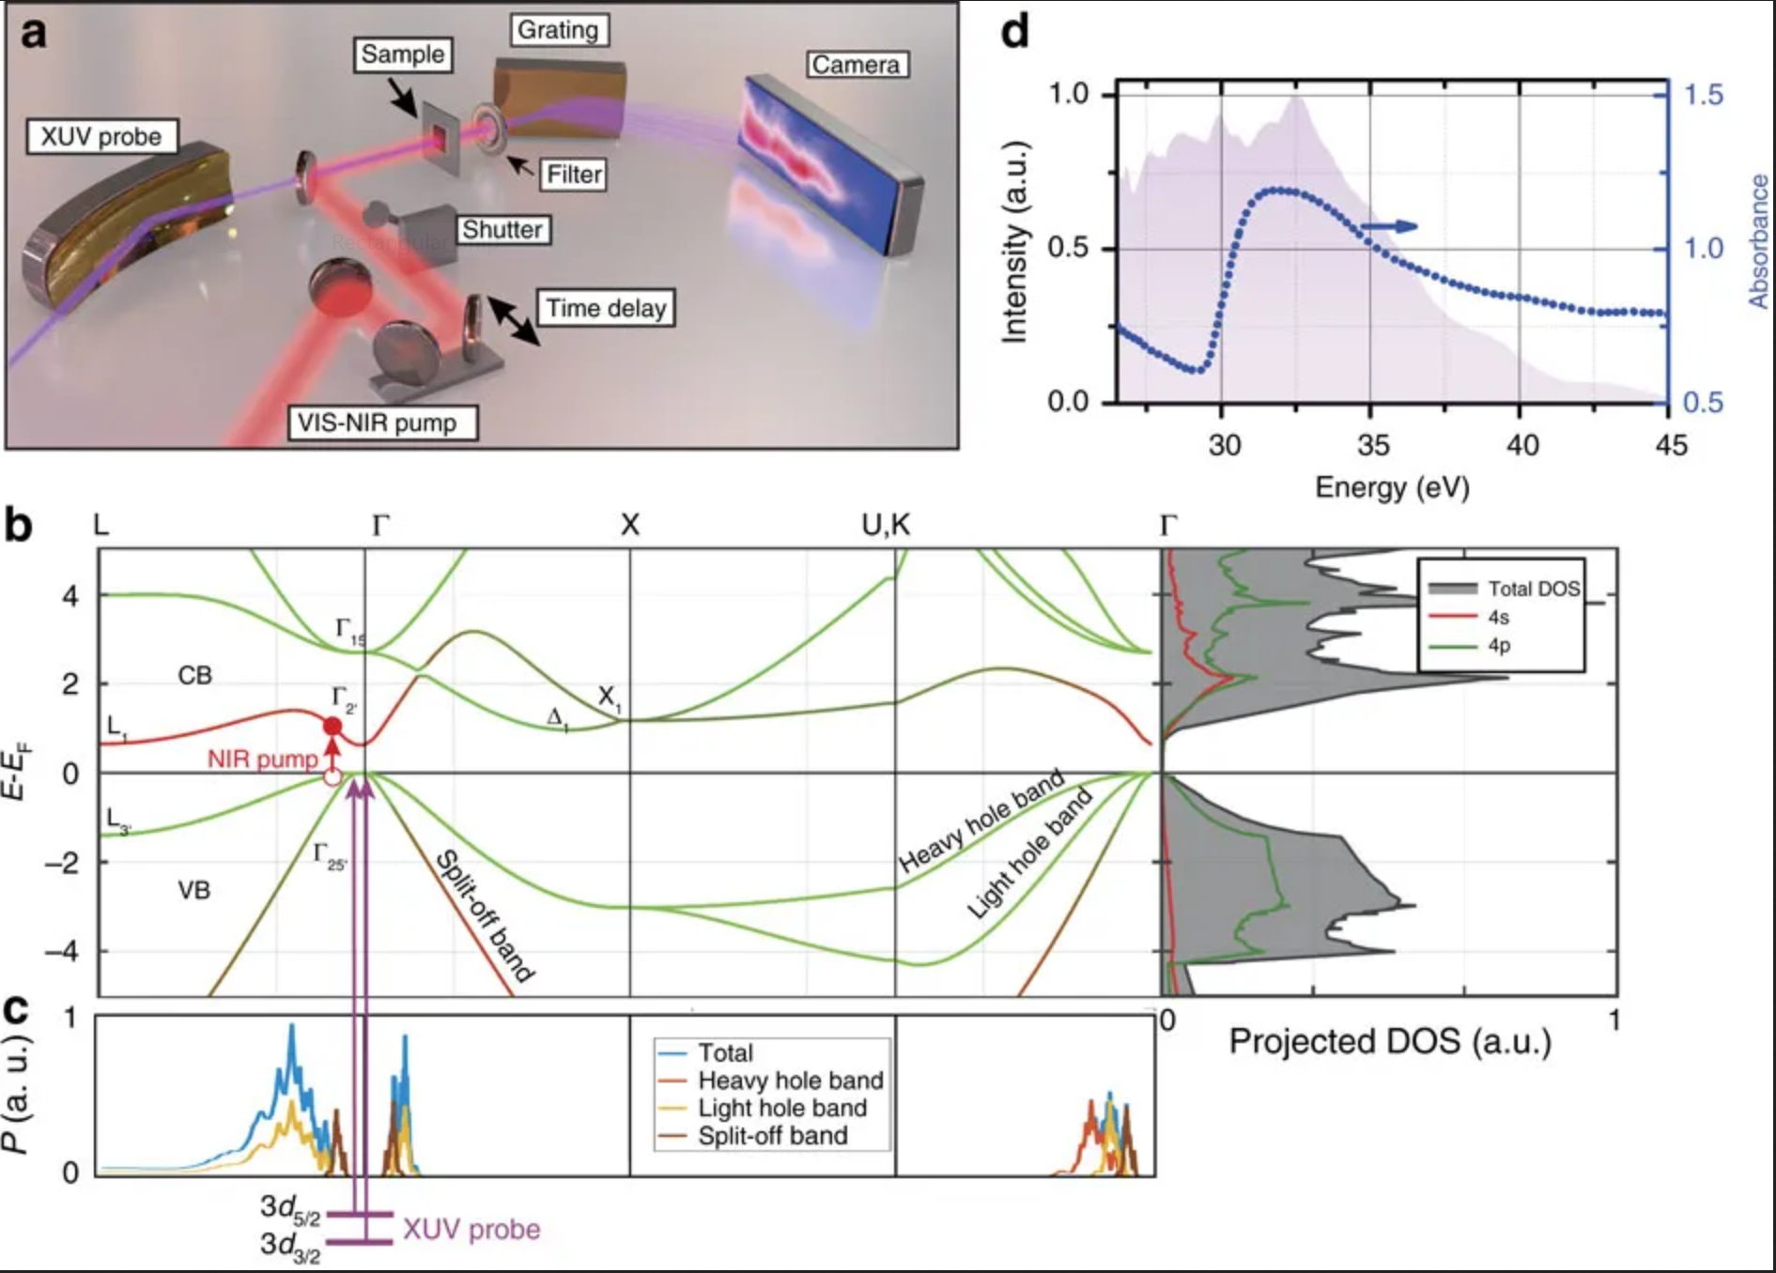
Germanium bandgap
M. Zürch, Nat. Commun. 8, no. 1, 15734 (2017)

Slide 14
Germanium bandgap
M. Zürch, Nat. Commun. 8, no. 1, 15734 (2017)

Slide 15
Germanium bandgap
M. Zürch, Nat. Commun. 8, no. 1, 15734 (2017)

Slide 16
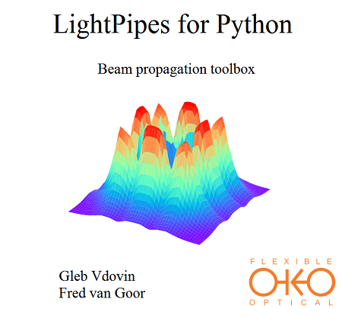
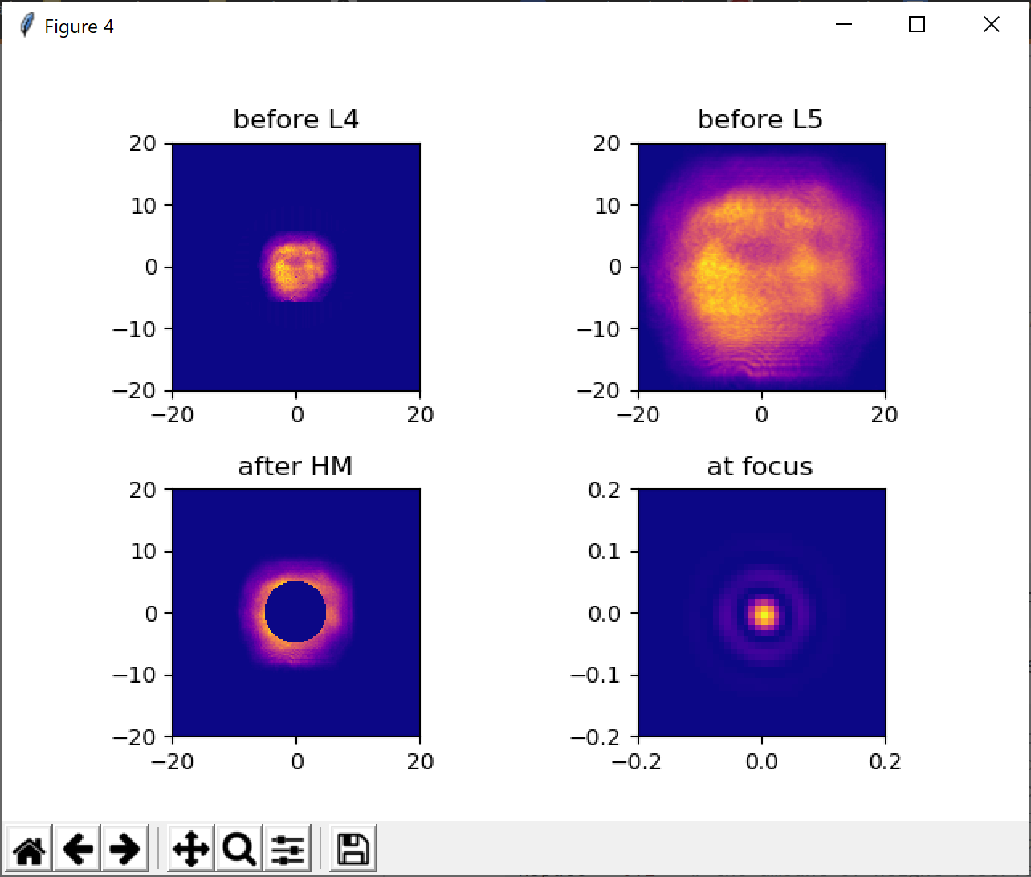
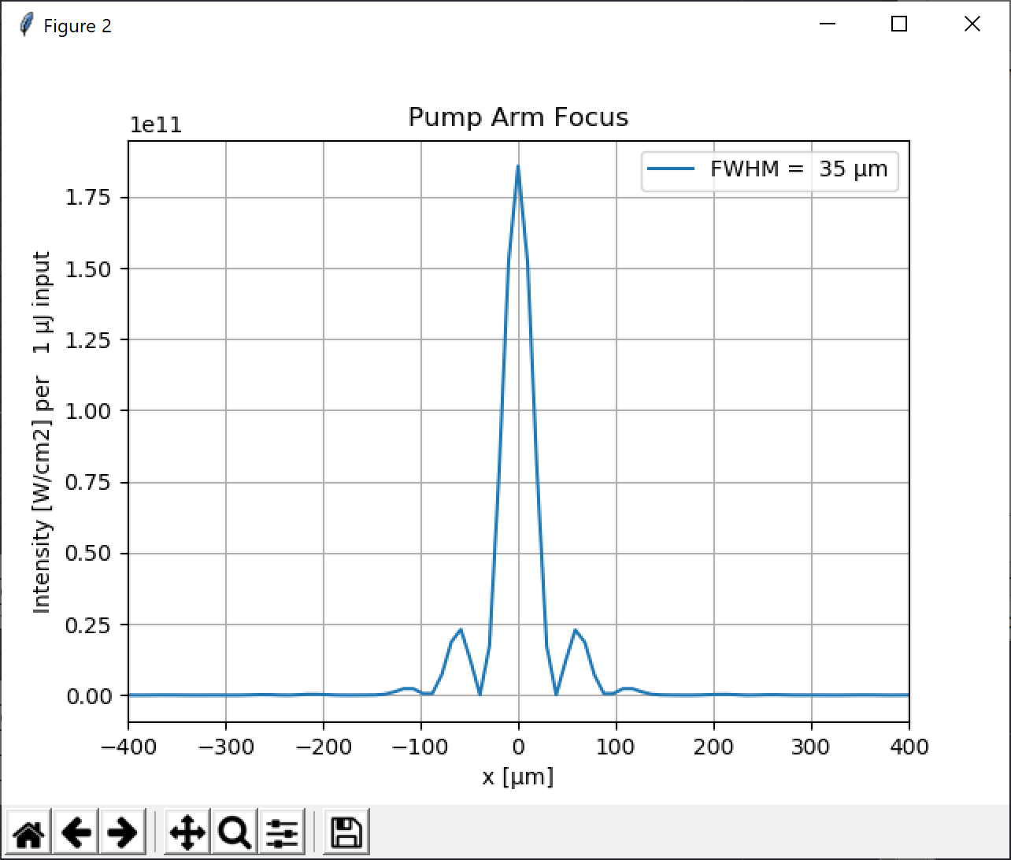
$$λ=1.5 μm$$
Notes:
20 mW = 20 mJ = 3.6 * 10^12 W/cm2
35 mJ = 6.3 * 10^12 W/cm2

Slide 17
Knife edge cartoon
XUV
XUV detector

Slide 18
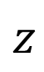
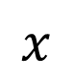
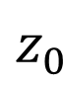
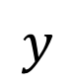
Knife edge cartoon
$$y$$
EM
$$z$$
$$x$$
XUV
XUV detector
$$z_{0}$$

